Slide 1


pamparisaivamshi7153@gmail.com
AUGUST - 2024
MobileNetV2 integration for high-performance image classification web app
Mrs K Triveni
PAMPARI SAI VAMSHI
217Y1A0547
S SAI PRANAY 217Y1A0545
1/12

Slide 2

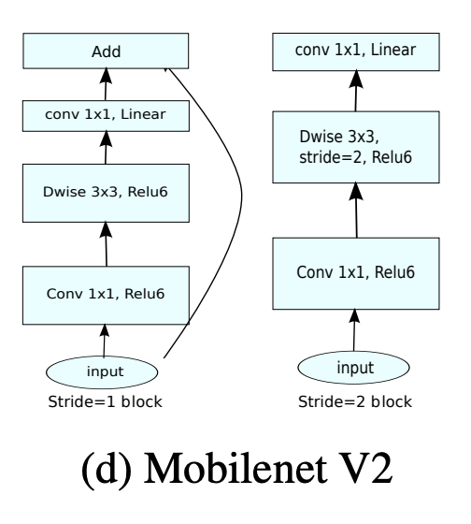
SYSTEM Architecture
2/12

Slide 3
FLOW CHART
graph TD A[Start] --> B{HTTP Request} B -->|GET|
C[Render upload.html] B -->|POST|
D{File uploaded?} D -->|No|
E[Return 'No file part'] D -->|Yes| F{Filename empty?}
F -->|Yes| G[Return 'No selected file'] F -->|No| H[Save file to uploads directory]
H --> I[Predict image using MobileNetV2]
I --> J[Render result.html with prediction and image filename]
J --> K[End]
3/12

Slide 4
FEATURES
1. Web Framework
2. Image Classification
3. Image Upload
4. Image Preprocessing
5. Prediction
6. Dynamic Directory Creation
7. Result Display
8. Error Handling
9. Debug Mode
4/12

Slide 5
EXISTING SYSTEM
[Start] | v
[User uploads image through web interface] | v
[Is file uploaded?] -- No --> [Show error message: No file uploaded] |
Yes | v [Save image in designated directory] | v
[Resize and preprocess image for MobileNetV2] | v
[Model predicts contents of the image] | v
[Display prediction results (class label, description, confidence)] | v
[End]
5/12

Slide 6
PROPOSED SYSTEM
+-------------------+ | | | User Interface | | (Upload Form) | | | +---------+---------+ |
| Uploads Image | +---------v---------+ | | | Image Upload | |
| +---------+---------+ | | Preprocesses Image | +---------v---------+ | |
| Image Processing | | | +---------+---------+ |
| Predicts Content | +---------v---------+ | |
| Prediction | | | +---------+---------+ |
| Displays Results | +---------v---------+ | |
| Results Display | | | +-------------------+ +-------------------+ +-------------------+ | |
| | | Static File | | Error Handling | | Handling | | | |
| | | +-------------------+ +-------------------+ +-------------------+ | |
| Model Utilization | | (MobileNetV2) | |
| +-------------------+
T
7/12

Slide 7
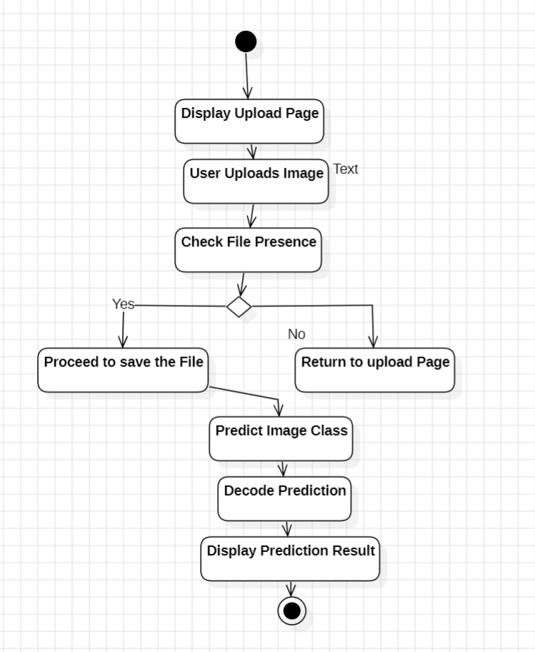
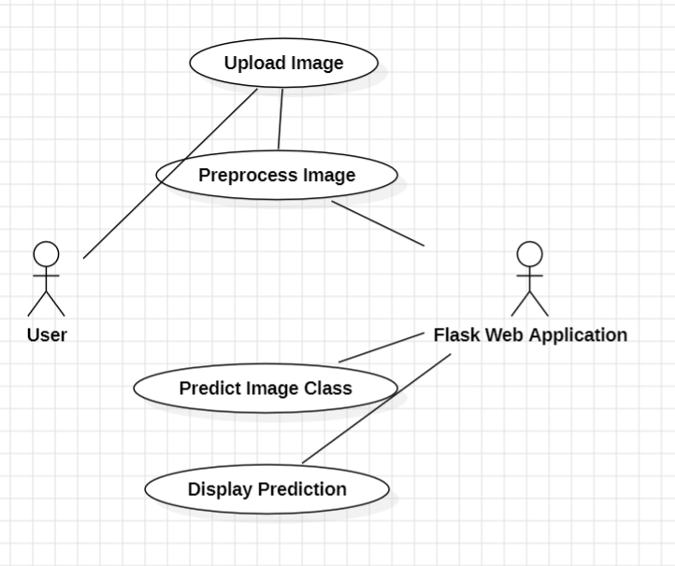
UML DIAGRAMS
Use Case Diagram
Activity Diagram
8/12

Slide 8
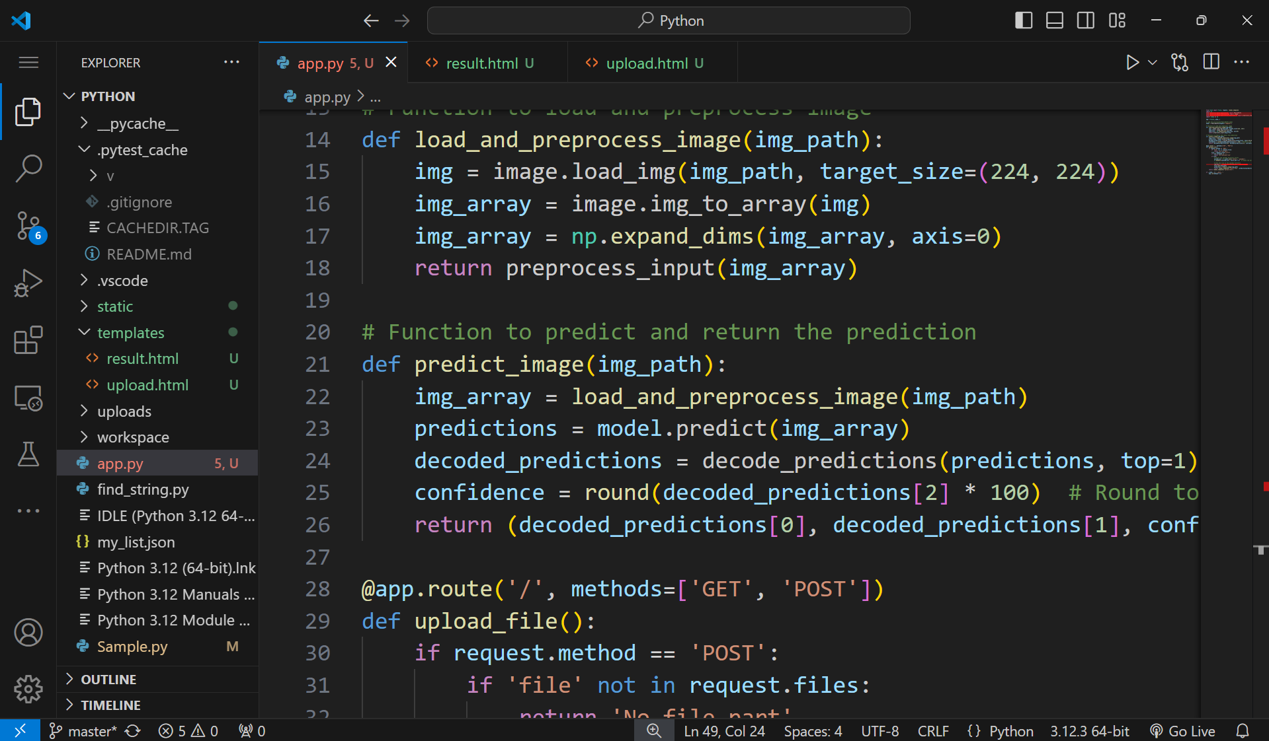
SAMPLE CODE
9/12

Slide 9
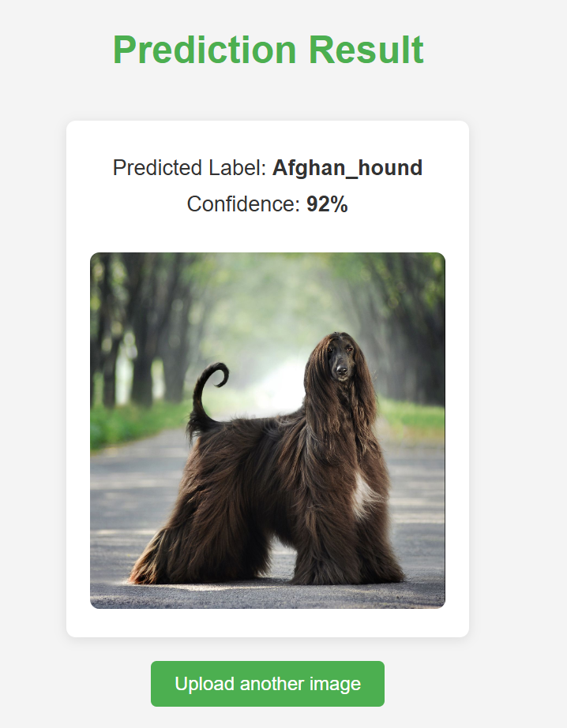
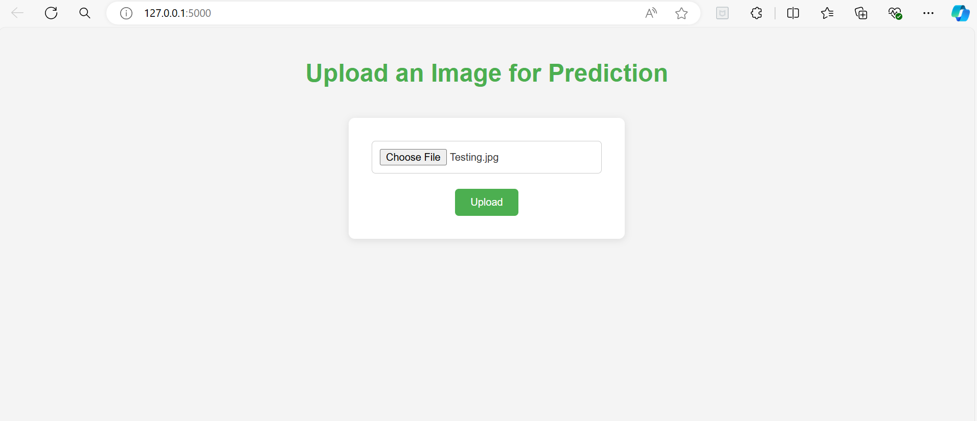
OUTPUT
Upload Image Overview
Prediction_result
10/12

Slide 10
CONCLUSION
It allows users to upload images through a web interface.
The uploaded images are saved in a designated directory on the server.
The application preprocesses the images to fit the model's input requirements.
It then uses the MobileNetV2 model to predict the content of the uploaded image.
The prediction includes the class label, description, and confidence level.
Results are displayed on a separate webpage after the image is processed.z
The application handles errors like missing files or no selected images.
It ensures the upload directory exists before saving files.
The app runs in debug mode for easier development and testing.
Overall, this application demonstrates how to integrate machine learning with a
web interface for image classification tasks.
11/12

Slide 11
THANK YOU
" For using our image classification app powered by MobileNetV2; we hope you enjoy your experience!”
12/12

